Slide 1

Laravel Lizard
Laravel project dependency manager and wizard.

Slide 2
whoami
Ignas Bernotas
Full-stack developer from Vilnius
Working @ Oberlo

Slide 3
What is it?
Essentially it’s a CLI GUI tool to ease up the process of setting up new Laravel projects.
Don’t you hate it when you need to repeat the same tasks for all your awesome Laravel projects? I know I do.
Adding Laravel composer packages, service providers, facades, composer scripts, bower components, gulp file, linters and so on. Lizard reduces the headache.

Slide 4
What’s in it?
A list of standard Laravel packages that come into pretty much all of my projects.
Bower configuration file and project file.
Enhanced gulp file

Slide 5
How to use it?
Install it via composer:
composer global require "ignasbernotas/lizard=*”
Setup a new Laravel project
laravel new awesome-project
Run Lizard via:
lizard init <path to project directory>

Slide 6
Package list
barryvdh/laravel-debugbar
barryvdh/laravel-ide-helper
laravelcollective/html
themsaid/laravel-langman
doctrine/dbal
intervention/image
patricktalmadge/bootstrapper
cviebrock/eloquent-sluggable
laracasts/flash

Slide 7
Limitations
Currently Windows isn’t supported due to the missing readline extension in Windows PHP installations.

Slide 8
Roadmap
Lizard 1.0
Add linters and QA configs (JSHint, JSLint, ESLint, PHPCS, PHPCPD)
Add CI configs (Travis CI, Gitlab CI, Jenkins)
Unit tests
Web interface and API to suggest and submit packages
Automatic stable package version updates
Locally cached customizable configurations (package lists, linters, CIs, etc.)
Windows support
Bugfixes

Slide 9
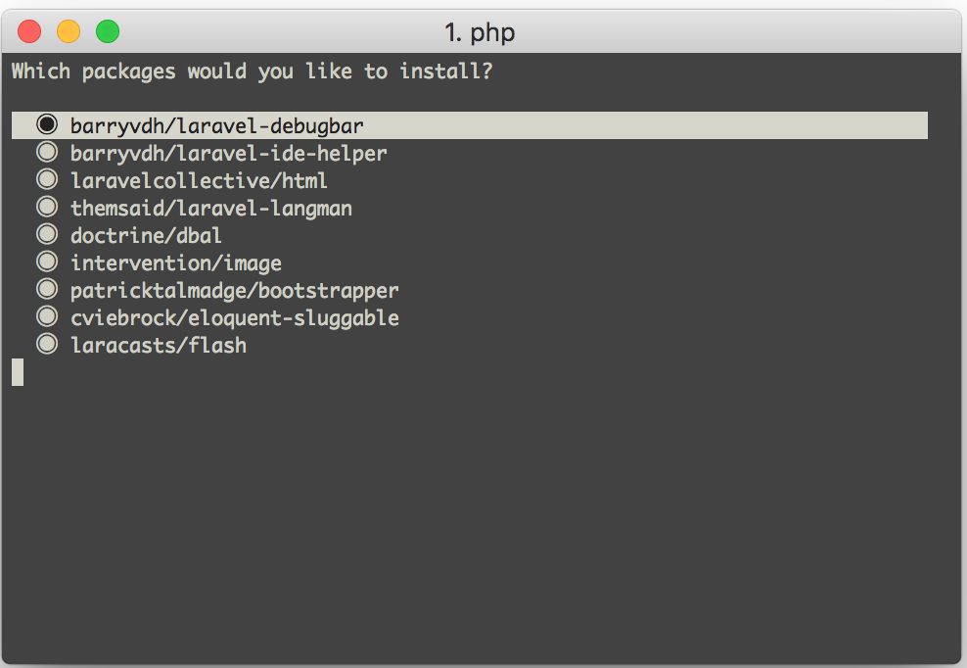
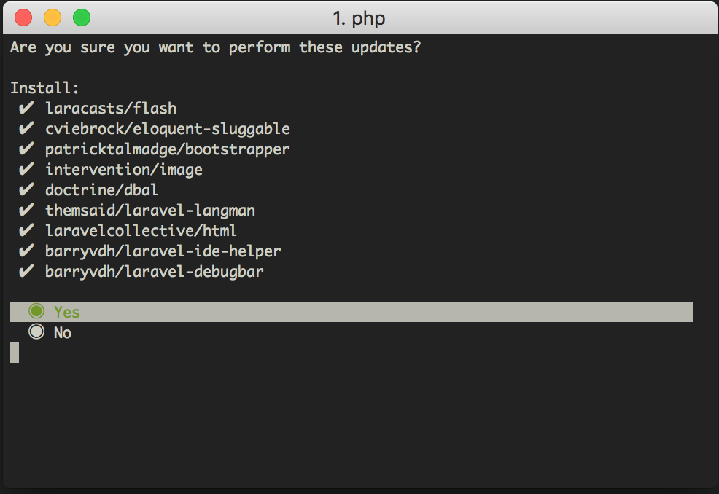
A few screenshots

Slide 10
Links
Lizard repo: https://github.com/ignasbernotas/lizard Phkey repo: https://github.com/ignasbernotas/phkey
Console repo: https://github.com/ignasbernotas/console

Slide 11
Thank you! Any questions?

